Slide 1

Design brief
Analysis of the first bus app from the perspective of an older retired person.

Slide 2
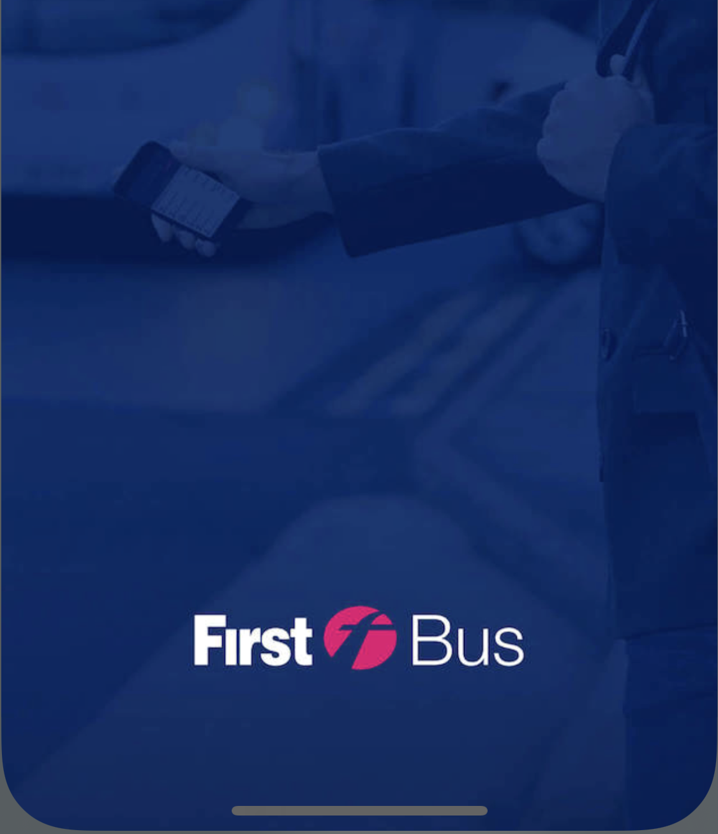
Current situation
Currently, the first bus app has many possible areas of improvement, but it also has a few good aspects about it. The app does well in catering towards an audience used to using a mobile device or finding information online.
However, there is very little concern for the older generation, and this shows with elements such as the font size or image scaling being rather small.

Slide 3

Design problems/challenges – what can be explored?
The main issue I have found with the first bus app is the layout, it is not inclusive and does not consider the possibility of users who may have trouble seeing or using the mobile.
Therefore, I am trying to improve the user experience for all users but mainly for the older generation in particular. This will be accomplished via a critique and analysis, finally, I will propose my own design recommendations.

Slide 4


User group
My specific user group is older retired people. The changes I propose will be useful for all generations but more so towards my specified user group.

Slide 5

Constraints
The restrains I face is restricted information. While I can look up ways to design apps for the older generation, I cannot find valid statistics of the first bus app userbase. This data would be crucial in designing an app and it will help focus on specific user group needs.

